Slide 1
Sql for Datascience

Slide 2

Procedures
We are what we repeatedly do. Excellence, then, is not an act but a habit.
Aristotle

Slide 3
Constructs
Programming

Slide 4
If-then statement
Text
The IF-THEN statement allows you to execute a set of SQL statements based on a specified condition.
IF condition THEN
statements;
ELSE
else-statements;
END IF;

Slide 5
If-then statement
Text
If you want to execute statements conditionally based on multiple conditions, you use the IF-THEN-ELSEIF-ELSE construct.
IF condition THEN
statements;
ELSEIF elseif-condition THEN
elseif-statements;
...
ELSE
else-statements;
END IF;

Slide 6
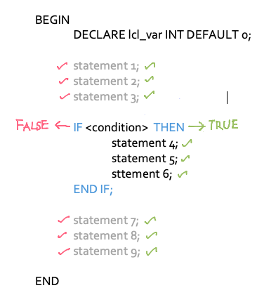
a. The ‘if’ statement
With the IF statement, we can perform specific tasks based on certain conditions
IF <condition> THEN
statements
END IF;
II

Slide 7
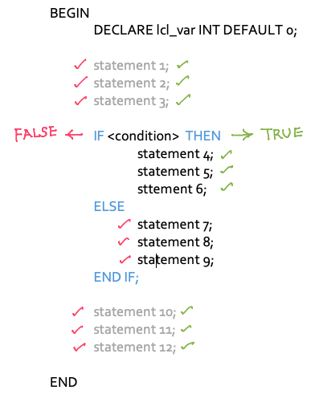
If - else statement
IF <condition> THEN
statements
ELSE
statements
END IF;

Slide 8
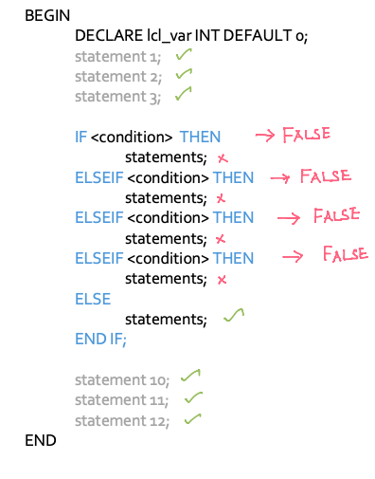
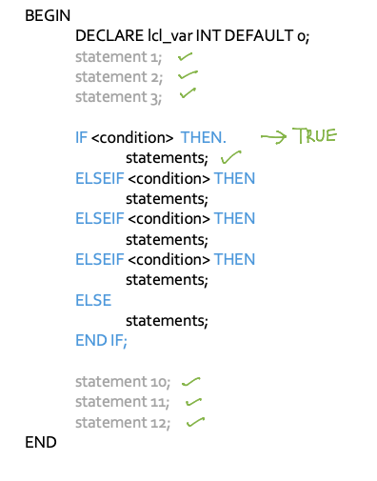
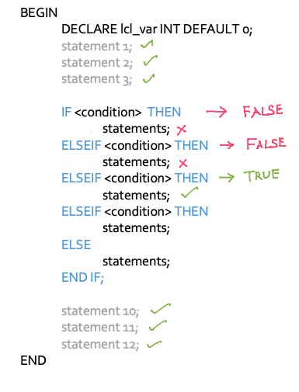
If - elseif - else

Slide 9
Case statement
Text
Besides the IF statement, MySQL provides an alternate conditional statement called the CASE statement for constructing conditional statements in stored procedures.
The CASE statements make the code more readable and efficient.
CASE case_value
WHEN when_value1 THEN statements
WHEN when_value2 THEN statements
...
[ELSE else-statements]
END CASE;
If the ELSE clause is not specified and the CASE cannot find any when_value equal to the case_value, it raises an error:

Slide 10
Case statement
Text
To avoid this, add an ELSE clause with an empty code block .
CASE case_value
WHEN when_value1 THEN statements
WHEN when_value2 THEN statements
...
ELSE
BEGIN
END;
END CASE;

Slide 11
Loop statements
Text
The LOOP statement allows you to execute one or more statements repeatedly.
[begin_label:] LOOP
statement_list
. . .

Slide 12
Loop statements
Text
The LOOP statement allows you to execute one or more statements repeatedly.
[begin_label:] LOOP
statement_list
. . .
-terminate the loop
IF termination_condition THEN
LEAVE [label];
END IF;
END LOOP [end_label]

Slide 13
Infinite loop
Text
The code below shows a very simple (and very dangerous) loop. It will continue forever, or at least until we manage to somehow terminate it.
In the meantime, the loop will consume as much CPU as it can.
Example : Infinite loop (don’t try this at home!)
Infinite_loop: LOOP
SELECT 'Welcome to my infinite loop from hell!!';
END LOOP inifinite_loop;
Obviously we almost never want to program an infinite loop, and therefore we need some way to terminate the loop. We can do this with the LEAVE statement.

Slide 14
Leave statement
Text
The LEAVE statement exits the flow control that has a given label.
LEAVE label;
The LEAVE causes the current loop specified by the label to be terminated.
If a loop is enclosed within another loop, you can break out of both loops with a single LEAVE statement.

Slide 15
Iterate statement
Text
The ITERATE statement is used to restart execution at the beginning of a loop, without executing any of the remaining statements in the loop.
When MySQL encounters the ITERATE statement, it recommences execution at the start of the nominated loop.
ITERATE has the following syntax:
ITERATE label;

Slide 16
ITERATE Example
Text
In this example, we print all odd numbers less than 10. ITERATE is used to repeat the loop if the number we have is not odd. LEAVE is used to terminate the loop once we reach 10.
Example Using ITERATE to return to the start of a loop
SET i=0;
loop1: LOOP
SET i=i+1;
IF i>=10 THEN /*Last number - exit loop*/
LEAVE loop1;
ELSEIF MOD(i,2)=0 THEN /*Even number - try again*/
ITERATE loop1;
END IF;
SELECT CONCAT(i," is an odd number");
END LOOP loop1;

Slide 17
Leave - Example
Text
Example Using LEAVE to terminate a loop
SET i=1;
myloop: LOOP
SET i=i+1;
IF i=10 then
LEAVE myloop;
END IF;
END LOOP myloop;
SELECT 'I can count to 10';

Slide 18
While loop
Text
The WHILE loop is a loop statement that executes a block of code repeatedly as long as a condition is true.
[begin_label:] WHILE condition DO
statement_list
END WHILE [end_label]
The WHILE loop is called a pre-test loop because it checks the search_condition before the statement_list executes.

Slide 19
Repeat statement
Text
The REPEAT statement executes one or more statements until a search condition is true.
[begin_label:] REPEAT
statement
UNTIL search_condition
END REPEAT [end_label]
The REPEAT executes the statement until the search_condition evaluates to true.

Slide 20
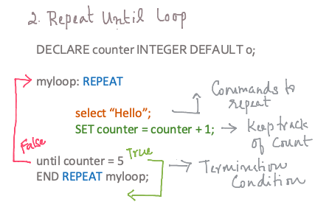
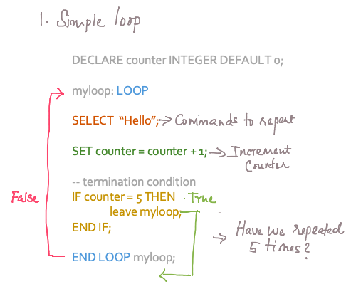
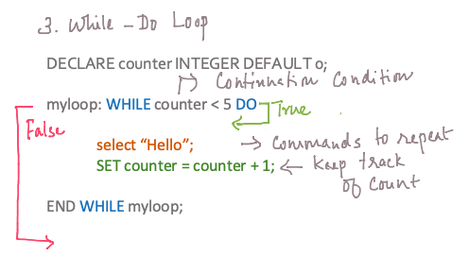
Loops

Slide 21
Exceptions
Handling

Slide 22
Exception handlers
Text
MySQL provides an easy way to define handlers that handle errors that range from general conditions such as warnings or exceptions to specific error codes.
DECLARE action HANDLER FOR condition_value statement;
The condition_value specifies a particular condition or a class of conditions that activate the handler. It accepts one of the following values:
A MySQL error code.
A standard SQLSTATE value like an SQLWARNING, NOTFOUND or SQLEXCEPTION condition.
The NOTFOUND condition is used for a cursor or SELECT INTO variable_list statement.
A named condition associated with either a MySQL error code or SQLSTATE value.
The action accepts one of the following values:
CONTINUE : The execution of the enclosing code block ( BEGIN … END ) continues.
EXIT : The execution of the enclosing code block, where the handler is declared, terminates.
The statement could be a simple statement or a compound statement enclosed by the BEGIN and END keywords.

Slide 23
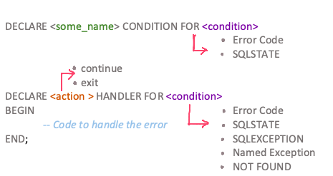
Exception Handling

Slide 24
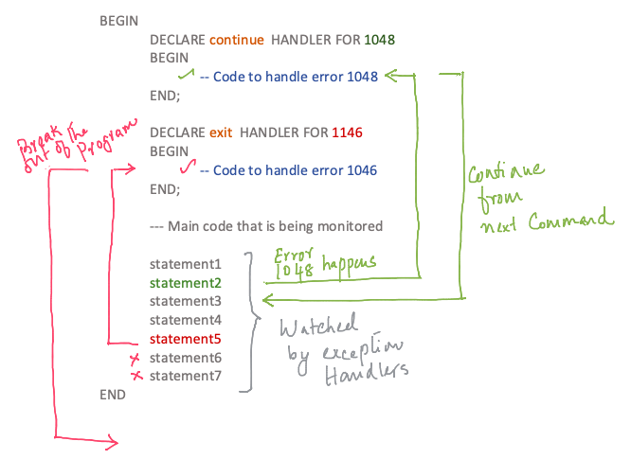
Control flow

